Slide 1

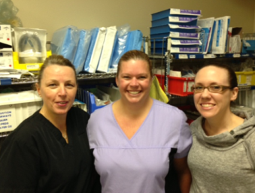
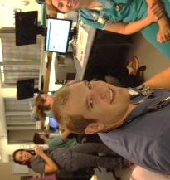

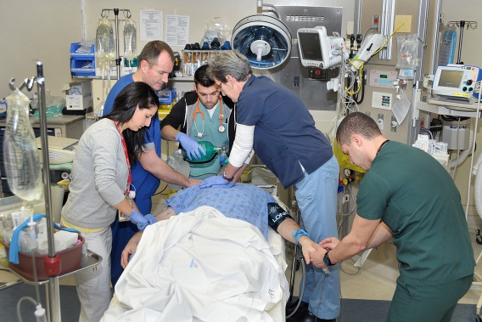
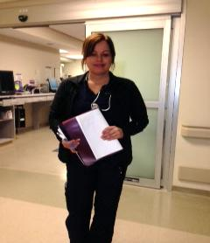

Welcome
LHSC Emergency Care Program
Nursing Orientation

Slide 2

Characteristics of the ED nurse

Slide 3

Calm Attitude

Slide 4

Use your resources….

Slide 5

Know your patient

Slide 6

Be Professional

Slide 7
Feelings I might experience
ED Nursing

Slide 8
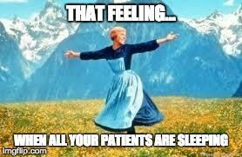
Peaceful Moments

Slide 9

Feeling Like Something May Happen Moment

Slide 10

Frustrating Moment

Slide 11

I Really Need a Moment

Slide 12

I Know Better Moment

Slide 13

ED Nursing
Opportunities

Slide 14

Educational Opportunity

Slide 15

Health Teaching Moment

Slide 16
ED Nursing
How my job might affect my significant others

Slide 17

When I am with others…..

Slide 18
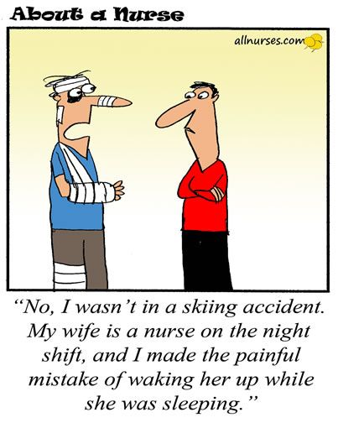
When someone close to me does something I might not like…

Slide 19

Developing traditions…..

Slide 20

ED Nursing
It’s up to you!

Slide 21


